Slide 1
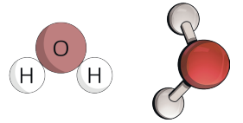
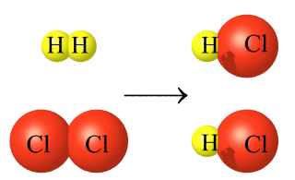
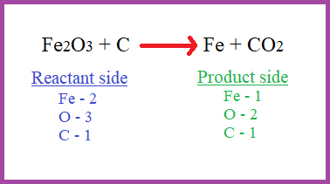
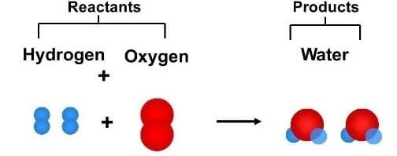
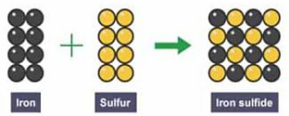


Knowledge Organiser
Year 8: Chemical Reactions - Compounds
How can we represent a chemical compound
The atoms in a chemical compound are chemically bonded
We can show this in lots of different ways
A formula tells you how many atoms of each element there are
CO₂ is the formula for carbon dioxide
We can also use particle diagrams like the ones below
Formulae | Name of compound
MgCl₂ | Magnesium chloride
NaNO₃ | Sodium nitrate
Fe₂O₃ | Iron oxide
MgCO₃ | Magnesium carbonate
BeS | Beryllium sulphide
CuSO₄ | Copper sulphate
Chemical vs Physical Changes
When a chemical reaction occurs, atoms are neither created or destroyed
Instead the atoms rearrange themselves, forming new bonds between atoms
Frying an egg and neutralisation are chemical changes
A physical change occurs when particles are rearranged but no new substances are made
Changes of state and dissolving are physical changes
Bonds are shown with the atoms touching
Bonds shown as sticks between the atoms
What is a balanced chemical equation?
A balanced equation is one where mass is conserved
The number of atoms of each element must be the same in the reactants and products
How do we write chemical equations?
A chemical equation shows how reactants are turned into products
The reactants are the substances which react together
Reactants are shown on the left of the arrow
The products are the substances which are made
Products are shown on the right of the arrow
Particle diagram which shows the formation of new bonds between atoms during a chemical change
An equation showing the unbalanced equation for the reaction between iron oxide and carbon
A labelled diagram showing the reactants and products in the reaction between hydrogen and oxygen
What is a compound?
A chemical compound is formed when two or more elements are chemically combined
The chemical compound will have different properties to the elements it made from
Sodium chloride (salt) is a white crystalline compound formed from sodium, a silvery reactive metal and chlorine, a yellow green gas
This is unbalanced because from reactants to products, an Iron and oxygen atom are lost.
How do we name chemical compounds?
When elements react together, the compound has a name which includes all the individual elements
Rule 1: The metal goes first in the name
e.g. Sodium + Chlorine → Sodium (metal) chloride (non-metal)
Rule 2:If there are just two elements the name of the compound ends in –ide, e.g. sodium chlorIDE
Rule 3: If there is a non-metal and oxygen present then the compound ends in –ate e.g. sodium chlorATE
RAG Yourself!
Learning Outcomes; | RAG
Describe the difference between chemical and physical changes
Describe the difference between compounds and mixtures
Explain why the properties of elements change when they react together
Describe what the different parts of a chemical equation mean
Write chemical word equations when given the reactants
Balance chemical symbol equations
Element
Element
Compound

Slide 2
Knowledge Organiser
Year 8: Chemical Reactions - Compounds
How can we represent a chemical compound
Formulae | Name of compound
MgCl₂
NaNO₃
Fe₂O₃
MgCO₃
BeS
CuSO₄
Chemical vs Physical Changes
Bonds are shown with the atoms touching
Bonds shown as sticks between the atoms
What is a balanced chemical equation?
How do we write chemical equations?
Particle diagram which shows the formation of new bonds between atoms during a chemical change
An equation showing the unbalanced equation for the reaction between iron oxide and carbon
A labelled diagram showing the reactants and products in the reaction between hydrogen and oxygen
What is a compound?
This is unbalanced because from reactants to products, an Iron and oxygen atom are lost.
How do we name chemical compounds?
RAG Yourself!
Learning Outcomes; | RAG
Describe the difference between chemical and physical changes
Describe the difference between compounds and mixtures
Explain why the properties of elements change when they react together
Describe what the different parts of a chemical equation mean
Write chemical word equations when given the reactants
Balance chemical symbol equations
Element
Element
Compound

